Slide 1

Presentation of
GETCLASSES
authors:
Jhon Gonzalez
Alejandro Escobar
Sebastian Sambrano

Slide 2


Índice
Introduction
Project objetive
System architecture
User Experience
Crc Cards
Technical Design (UML Diagram)
Requirements Documentation
Non-Functional Requirements
Mockups (Diseño de interfaz)

Slide 3

Introduction
The GetClasses project is an online platform
intuitive and secure learning environment.
The system aims to create an ecosystem where students can easily find qualified tutors according to subject, price, or location, while tutors can promote their academic skills and manage their teaching schedules.
The motivation for this project arises from the growing demand for remote learning solutions that offer accessibility and trust. The main objective of GetClasses is to facilitate academic connection, communication, and payment between users within a unified platform. The scope includes web operations, multilingual support, and user management for tutors and students.

Slide 4

Project objetive
The main objective of the GetClasses project is to design and implement an online tutoring platform that efficiently connects students with qualified tutors through a secure, scalable, and user-friendly system. The platform aims to streamline the processes of registration, scheduling, communication, and payment between users, applying object-oriented design principles such as inheritance, polymorphism, and encapsulation to ensure modularity, maintainability, and reusability of the software components.
Enabling students to find, book, and attend virtual tutoring sessions easily.
Allowing tutors to manage their profiles, availability, and earnings effectively.
Providing administrators with tools to supervise transactions and resolve disputes.
Guaranteeing data security, reliability, and smooth user experience across web and mobile platforms.
Demonstrating the practical application of OOP concepts in a real-world transactional application.

Slide 5

System architecture
In GetClasses, the system’s main operations are driven by user interactions. Students can create accounts, search for tutors, book classes, and complete payments through integrated modules. Tutors, in turn, manage their profiles, set availability, and interact with students through chat and virtual sessions. The administrator ensures compliance and resolves disputes.
The data flow of the platform is summarized as follows: users enter their data through web forms, which are processed and validated by the backend. Once authenticated, the system stores user information, manages session scheduling, and logs transaction records. Notifications are automatically triggered to keep users informed of bookings, payments, and reviews.

Slide 6

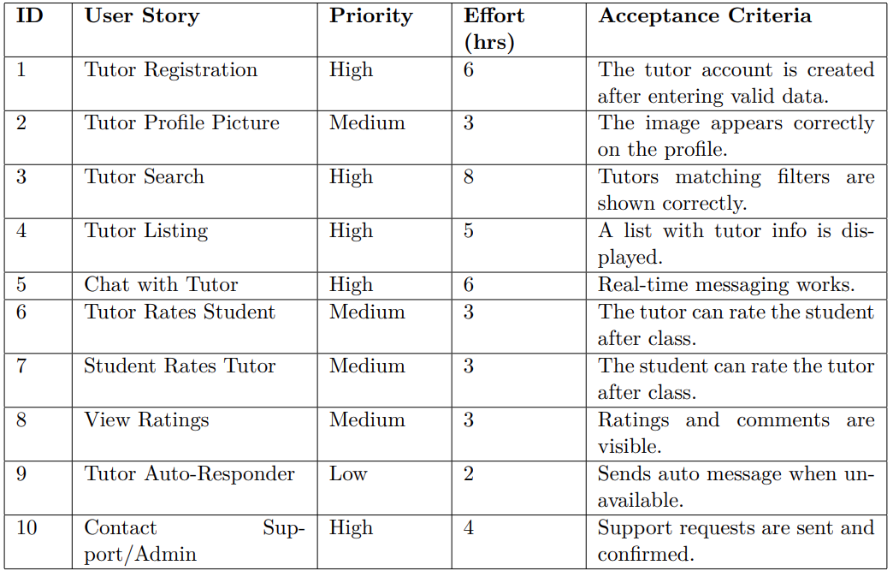
User Experience

Slide 7
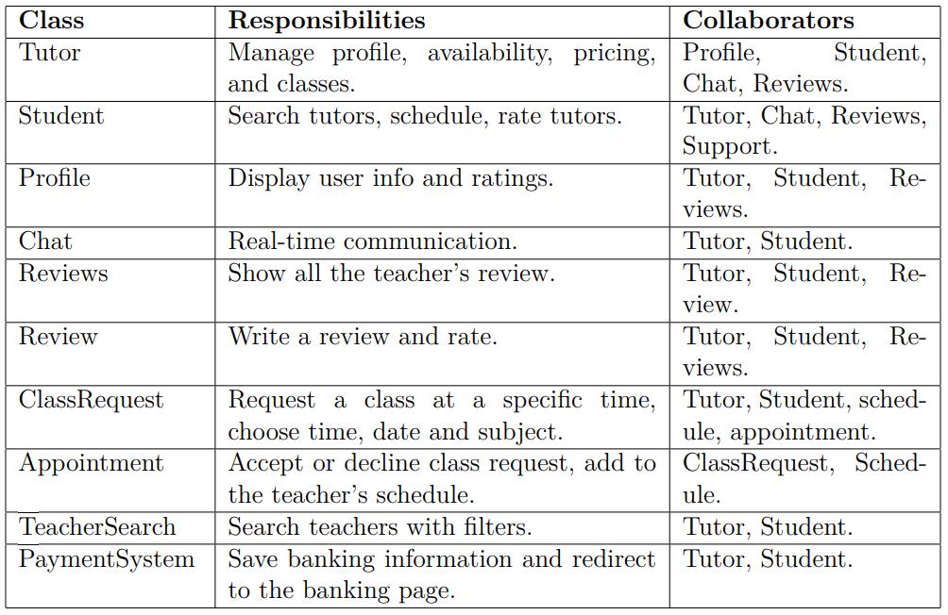
Crc Cards

Slide 8
Technical Design (UML Diagram)
The following UML class diagram represents the conceptual structure of the GetClasses system. It illustrates inheritance relationships, attributes, methods, and associations between main entities.
The diagram highlights class hierarchies where the base class User acts as the parent of specialized subclasses StudentUser, TutorUser, and AdminUser. Each subclass extends the base behavior to meet specific user needs, demonstrating OOP principles such as inheritance, polymorphism, and encapsulation.

Slide 9
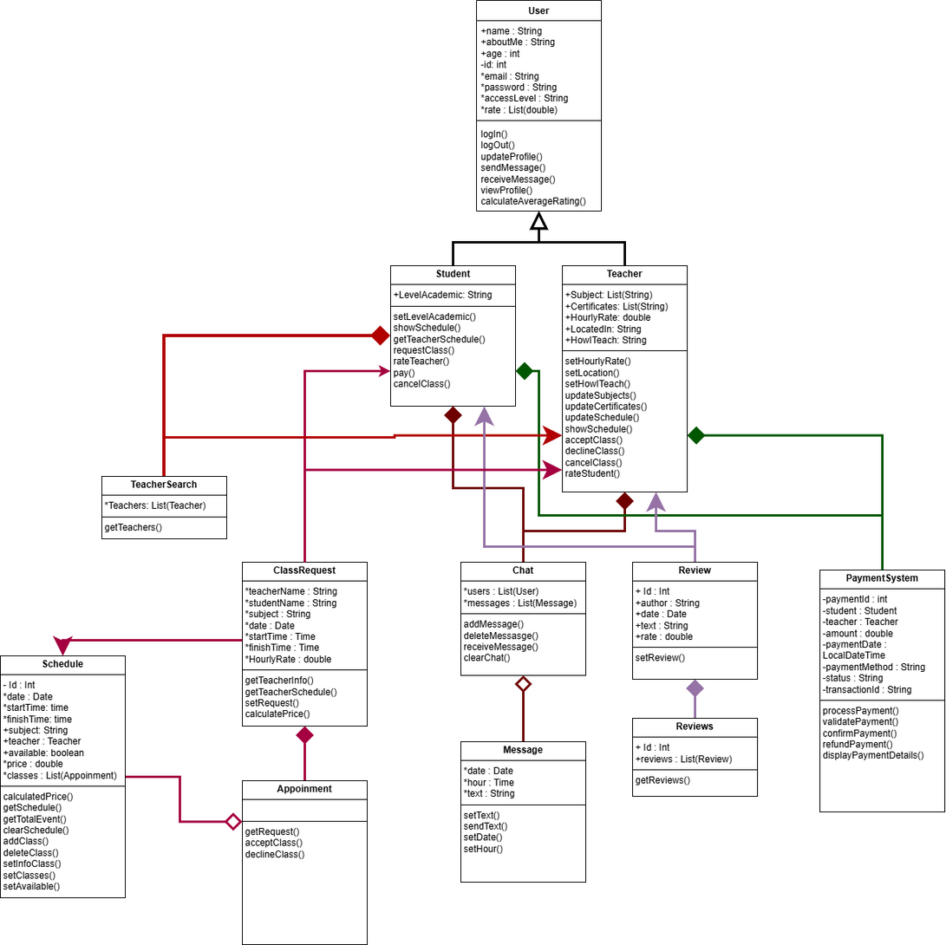
Technical Design (UML Diagram)

Slide 10
Requirements Documentation
Functional Requirements
Registration and login for students and tutors.
Profile management including experience, degrees, rate, and availability.
Tutor search with filters by subject, rate, language, and country.
Scheduling with notifications.
Secure payments (credit card, e-wallet).
Virtual classes with video call, screen sharing, and whiteboard.
Chat and messaging between users.
Reviews and ratings after sessions.
Dispute management by the administrator.

Slide 11
Non-Functional Requirements
•Performance: The system must respond to search queries in less than three seconds to ensure smooth navigation and usability. It should support at least 1000 concurrent users without degradation in performance.
Usability: A clean and intuitive interface accessible from both web and mobile devices, supporting multiple languages (English/Spanish), to guarantee accessibility for diverse users. •
Security: Data encryption, credential protection, and tutor identity verification to ensure user trust and compliance with PCI DSS standards.
Availability: 99% uptime is required for service
reliability, supported by automated daily backups and error recovery systems.
Flexibility: The architecture should allow integration of future features (e.g., group sessions or additional payment methods) without major structural changes.

Slide 12
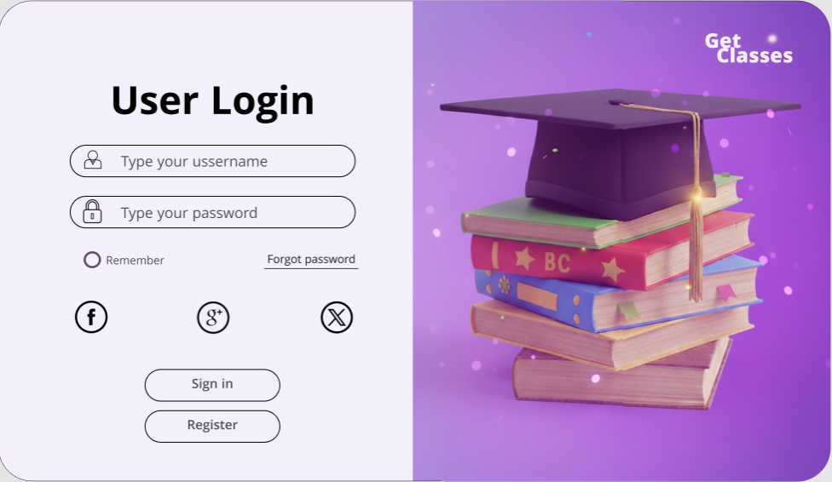
Mockups

Slide 13
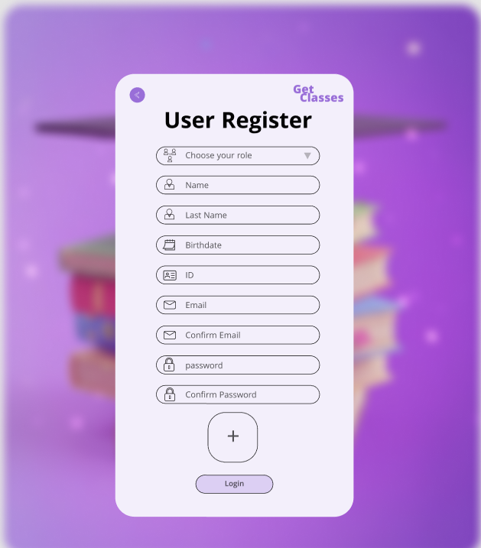
Mockups

Slide 14
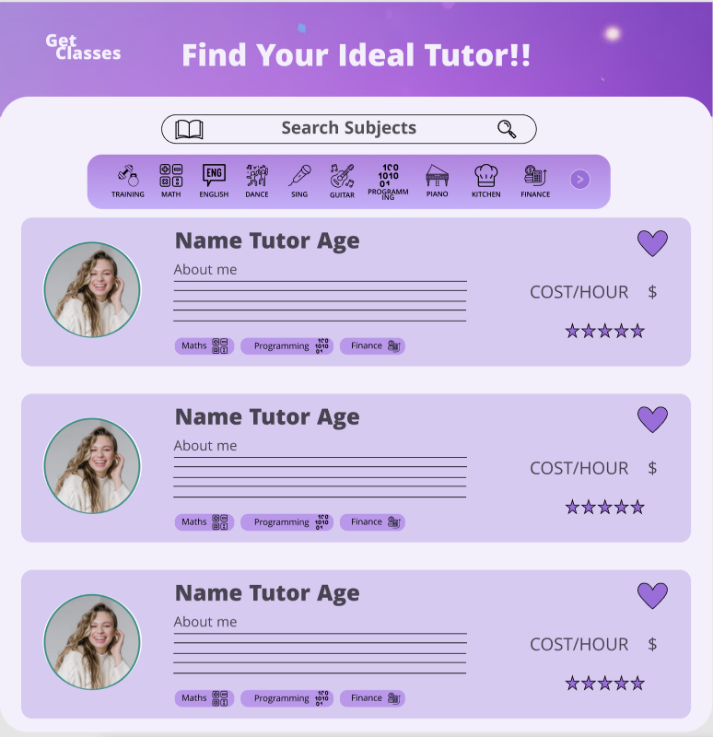
Mockups

Slide 15
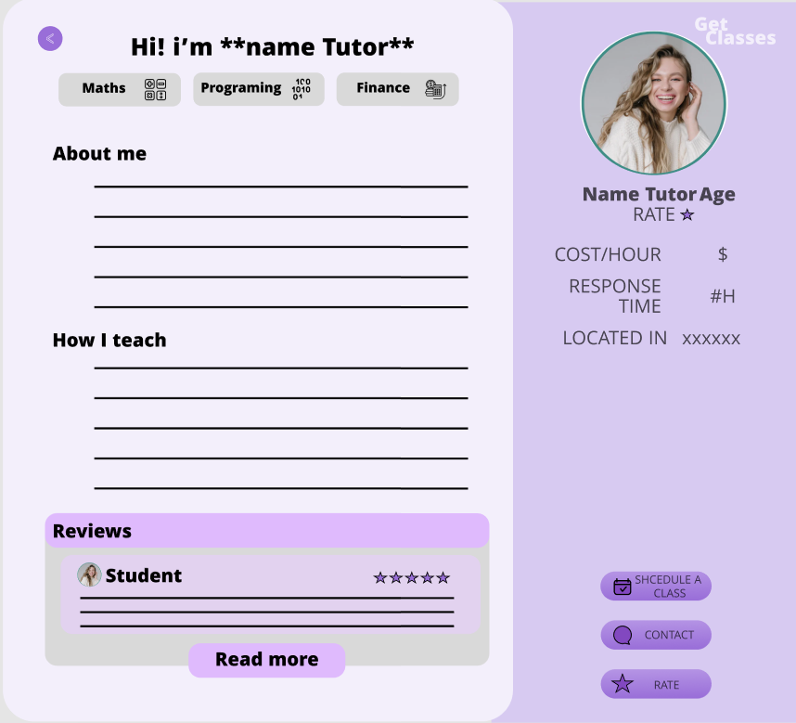
Mockups

Slide 16
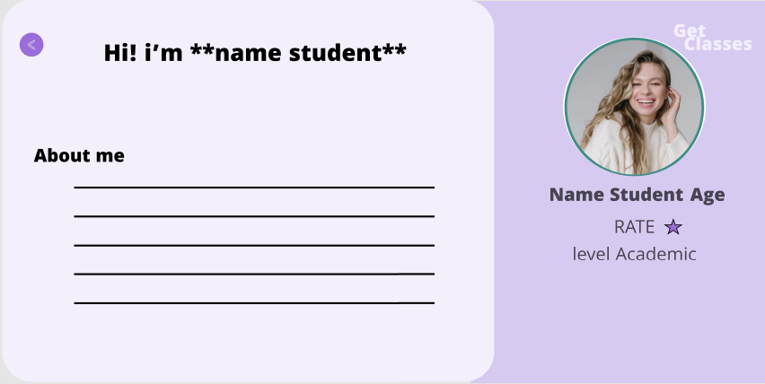
Mockups

Slide 17
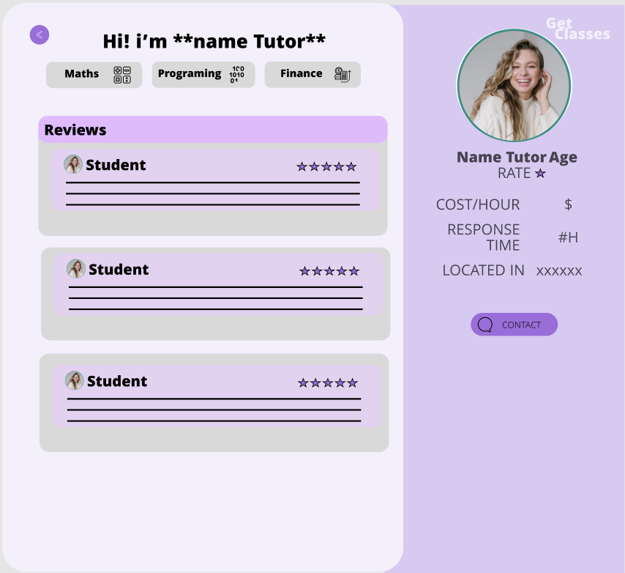
Mockups

Slide 18
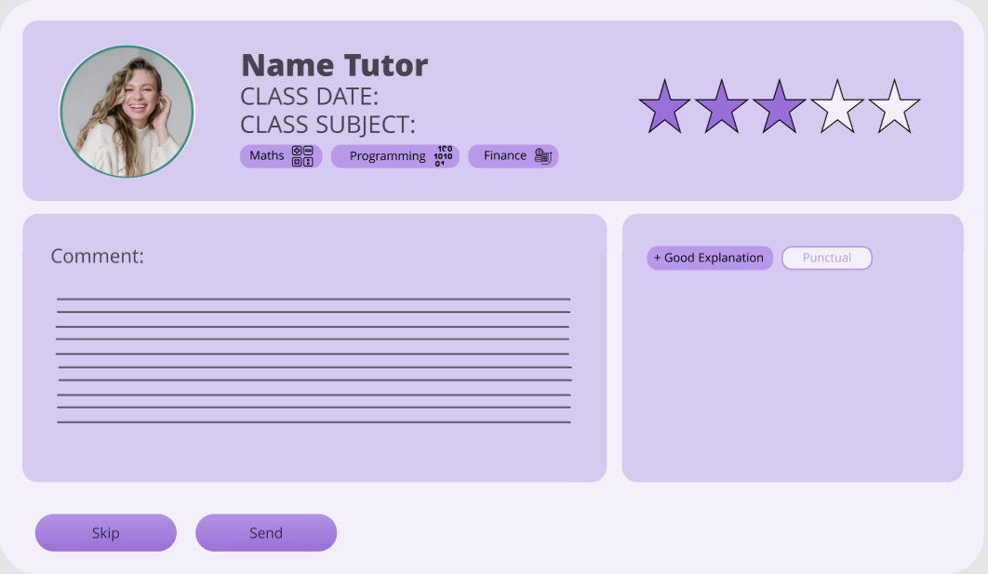
Mockups

Slide 19
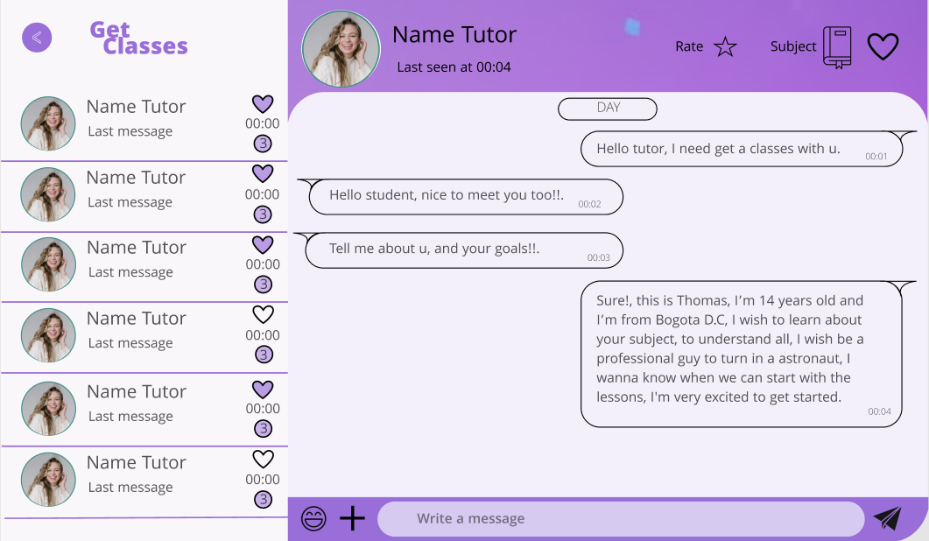
Mockups

Slide 20
THANKS

